Slide 1
Dynamic Programming-Multi Stage Graph

Slide 2
Dynamic programming
Dynamic programming approach is similar to divide and conquer in breaking down the problem into smaller and yet smaller possible sub-problems.
But unlike, divide and conquer, these sub-problems are not solved independently.
Results of these smaller sub-problems are remembered or recorded and used for similar or overlapping sub-problems.
The solutions of sub-problems are combined in order to achieve the best solution.
Mostly, these algorithms are used for optimization.

Slide 3
Principle of Optimality
Definition: A problem is said to satisfy the Principle of Optimality if the subsolutions of an optimal solution of the problem are themesleves optimal solutions for their subproblems.
Examples:
The shortest path problem satisfies the Principle of Optimality.
This is because if a,x1,x2,...,xn,b is a shortest path from node a to node b in a graph, then the portion of xi to xj on that path is a shortest path from xi to xj.
The longest path problem, on the other hand, does not satisfy the Principle of Optimality. Take for example the undirected graph G of nodes a, b, c, d, and e, and edges (a,b) (b,c) (c,d) (d,e) and (e,a). That is, G is a ring. The longest (noncyclic) path from a to d to a,b,c,d. The sub-path from b to c on that path is simply the edge b,c. But that is not the longest path from b to c. Rather, b,a,e,d,c is the longest path. Thus, the subpath on a longest path is not necessarily a longest path.

Slide 4
Example
Dynamic programming can be used in both top-down and bottom-up manner
The following computer problems can be solved using dynamic programming approach −
Fibonacci number series
Knapsack problem
Tower of Hanoi
All pair shortest path by Floyd-Warshall
Shortest path by Dijkstra
Project scheduling

Slide 5
Multistage graph problem
The multistage graph problem is to find a minimum cost from a source to a sink.
A multistage graph is a directed graph having a number of multiple stages, where stages element should be connected consecutively.
In this multiple stage graph, there is a vertex whose in degree is 0 that is known as the source. And the vertex with only one out degree is 0 is known as the destination vertex.
The one end of the multiple stage graphs is at i thus the other reaching end is on i+1 stage.
If we denote a graph G = (V, E) in which the vertices are partitioned into K >= 2 disjoints sets, Vi, 1 <= I <=K. So that, if there is an edge < u, v > from u to v in E, the u £Vi and v € v (i+1), for some I, 1 <= i <= K. And sets V1 and Vk are such that |V1| = |Vk| = 1.

Slide 6
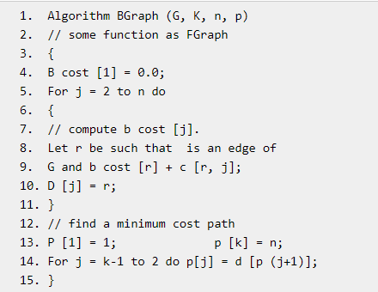
Algorithm for Forward Approach

Slide 7
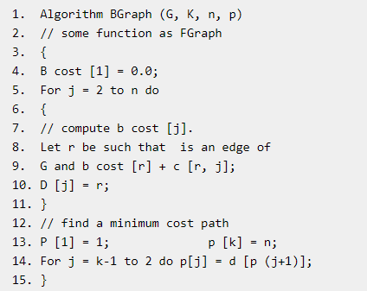
Algorithm for Backward Approach

Slide 8
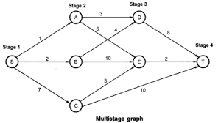
Solve the following multi-stage graph using forward and backward approach and find the optimal path

